Slide 1

The Weekend Navigator
Session 2
Pre-voyage Planning

Slide 2
The Weekend Navigator
Dead Reckoning Plot &
Planning with Paper Charts

Slide 3

The Weekend Navigator
Cruise Problem #1 Review

Slide 4
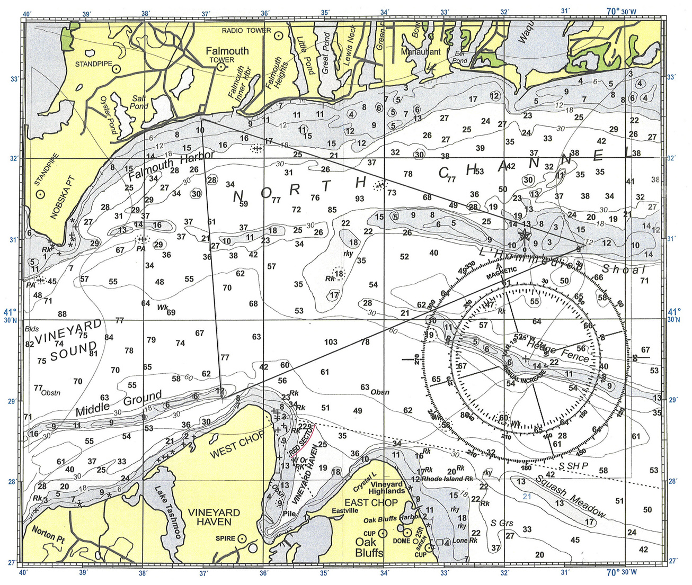
Exercise #1 Homework
Notes:
Leg #1 Course is 190M 3.5 nm
Leg #2 082M 4.8 nm
Leg #3 304M 4.9 nm -all rounded

Slide 5
Dead Reckoning
DR- A way to approximate a boat’s present position by advancing a known past position for courses and distances traveled
DR Plot- Chart plot of course and projected positions based on heading steered and boat speed through the water (STW)

Slide 6
DR Labels
DR Plot
C 090 M
S 10.5 or D 3.6
DR Position
0930
1000
Electronic Fix
1500 RADAR
1100
LOP
1100
Visual Fix
045 M
1100
1100
045 M
130 M
Notes:
There is not a cogent list of labels in the text, but they are given in the Instructor/Student Guides. These labels are taken from the text and also are shown in Chapman.
On the DR Plot line:
The text uses magnetic courses exclusively, not true.
According to Chapman, if the Speed is known (S 10.5), use that, if it is not, use the Distance (D 3.6). On the computer generated plots that follow, you’ll see the Distance. In the text (e.g., Fig. 12-6) the author shows the original DR plot with Distance and the new, underway, course with Speed.
All bearings in the text are given as magnetic, not true.

Slide 7
Class Exercise-DR Plot
Label the legs in Exercise 1 as a DR plot with C and S given that:
  You intend to depart on this trip at 1:00 pm and your pier’s location is fixed by GPS.
  You intend to maintain 15 knots (kn) to each waypoint
  Use labels like these:
Electronic Fix
DR Plot
C 190 M
1300 GPS
S 15.0

Slide 8
1300 GPS
C 304 M
S 15.0
C 190 M
S 15.0
C 082 M
S 15.0
Notes:
Here’re the legs labeled. Next the students will calculate the DR times.

Slide 9
How Long Will Each Leg Take?
60(minutes) x Distance(nm) = Speed(kn) x Time(minutes)
60D = ST
“Sixty D Street”
60 x D
S
T

Slide 10
“Sixty D Street”
T: You travel 3.5 nm at 15 kn. How long did it take?
60 x 3.5 nm = 210 ÷ 15 kn = 14 min
S: You travel 3.5 nm in 14 min. How fast?
60 x 3.5 nm = 210 ÷ 14 min = 15 kn
D: You cruise at 15 kn for 14 min. How far have you moved?
15 kn x 14 min = 210 ÷ 60 = 3.5 nm
60 x D
S
T

Slide 11
Class Exercise-DR Plot
Calculate the projected arrival times to the waypoints (WPT):
  You will slacken speed momentarily as you pass over the WPT and check your fish-finder for activity, but won’t actually stop.
  You intend to maintain 15 kn to each waypoint
  Plot your arrival time at each WPT as a DR position using labels like these:
DR Position
0930
1000

Slide 12
1300 GPS
1353
C 304 M
S 15.0 D 4.9
1333
S 15.0 D 3.5
C 190 M
C 082 M
S 15.0 D 4.8
1314
Notes:
The distance “D” isn’t part of the DR labeling convention we are used to, but appears on the legs developed using charting programs and it appears in the text. Chapman says to use S if known or D if it’s not, however it’s the navigator’s choice to show both. The distances are included here for convenience in discussing the class exercise.

Slide 13
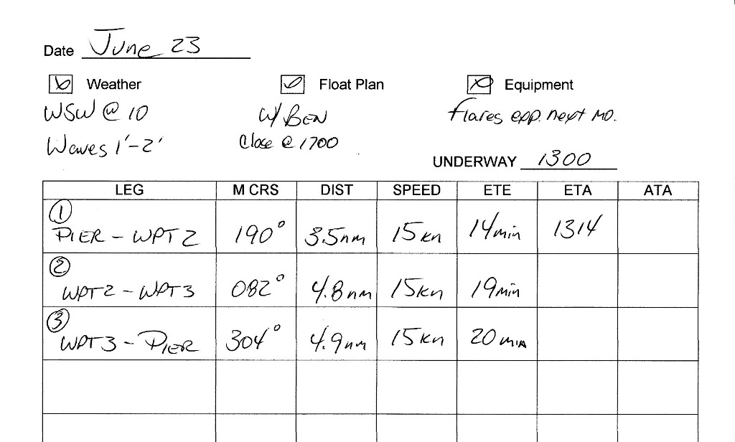
Navigation Log
Useful to have navigation information available underway
Notes:
The estimated time enroute (ETE) is added to the departure time to calculate the estimated time of arrival (ETA) at WP2. As the trip progresses, the ETA to WP3 will be computed based on the actual time of arrival (ATA) at WP2.
Write large so that the log is easy to read underway.
These logs can be very simple compared to the legally required logs for commercial vessels. The goal is to help the navigator/helmsman operate safely and efficiently.

Slide 14
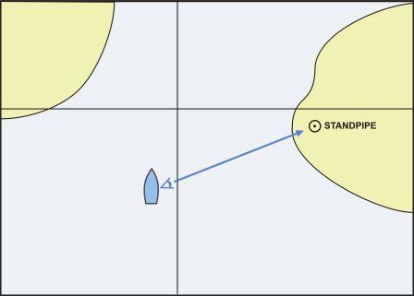
A Fundamental Concept:
Bearings
True bearing (T)
With hand bearing compass (M)
With ship’s compass (C)
Reciprocals
Ranges
Relative
bearings (R)
Fig 2-1A
Notes:
Discuss the first 4 bullets from this slide and using a blackboard. Ranges and relative bearings have slides.
Since Bearings are fundamental to DR, they are discussed here. Using TVMDC + W to correct compass bearings is addressed in Session 3.
A Class Exercise for plotting bearings is provided in the “Additional Slides,” after the end of the presentation.

Slide 15
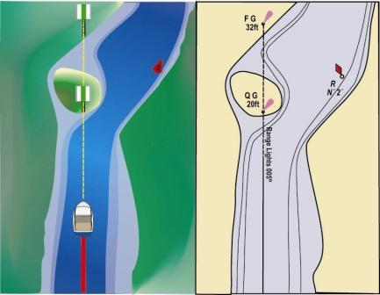
Ranges Provide Bearings
Any visible pair of landmarks can be a range
What are some local examples of ranges?
Fig 2-12

Slide 16
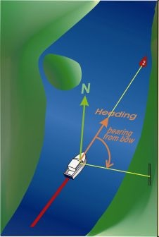
Relative Bearings
Relative bearing is taken with respect to the bow of your boat
Tower bears 090° R
Fig 2-13
Notes:
Understanding relative bearings is fundamental to understanding the radar presentation in Session 5.

Slide 17

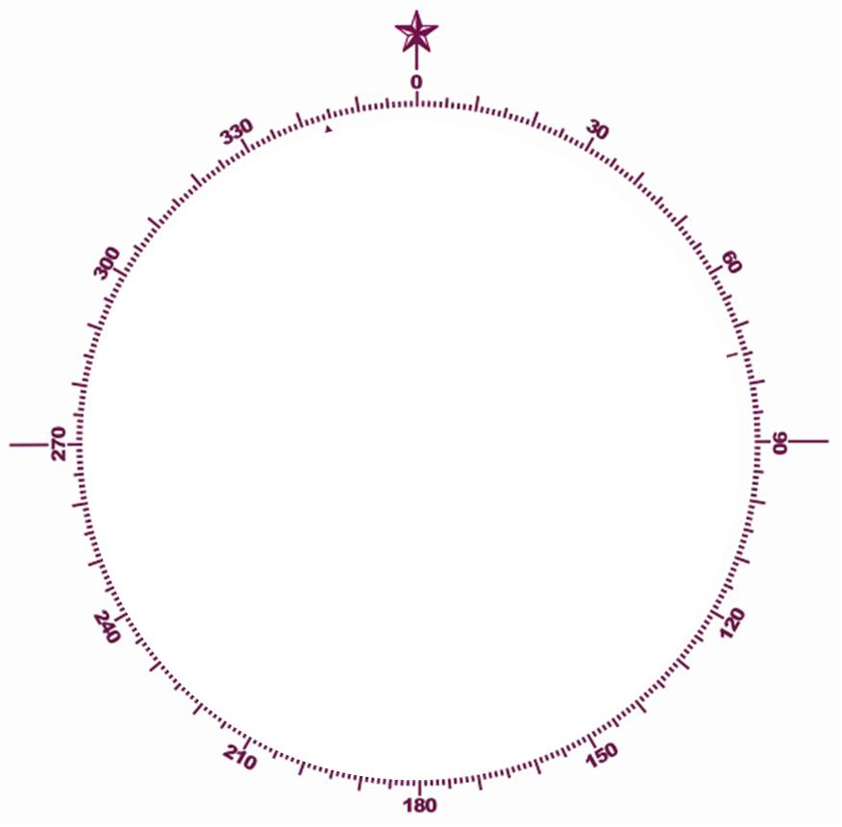

Relative Bearings
045° R
Vessel
Heading ???
310° R
257° R
090° R
155° R
Fig 2-13
Notes:
Relative bearings are made clockwise from the bow of the vessel. The vessel’s heading is irrelevant at this point.
Calculations using these R bearings and changing vessel headings are provided in the “Additional Slides” which are included after the end of the Session 2 presentation.

Slide 18
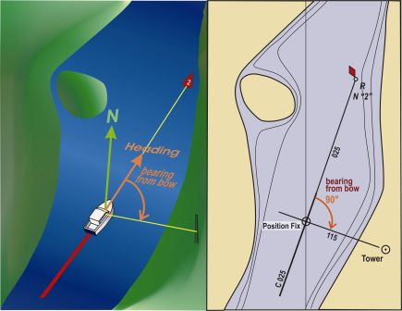
Relative Bearings
Must be converted before plotting on a chart
Fig 2-13

Slide 19
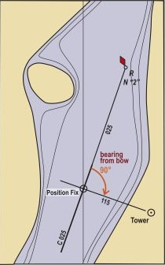
Convert a Relative Bearing?
Can use Magnetic or True headings
Ship’s M Heading + Relative Bearing = M Bearing
MH + RB = MB
025°+ 090° =115°
Notes:
The abbreviations here are not standard, but are used to make a simple memory device.
Compass headings/bearings can be used, but a correction for deviation (and variation if calculating true bearings) must be made.
CH +/- dev + RB = MB

Slide 20
Class Exercise- MH+RB=MB
Calculate the M bearings:
MH 180°
RB 180°
MB 000°
MH 020°
RB 210°
MB 230°
MH 222°
RB 240°
462°
- 360°
MB 102°
Notes:
Calculations using R bearings and changing vessel headings are provided in the “Additional Slides” which are included after the end of the Session 2 presentation.

Slide 21
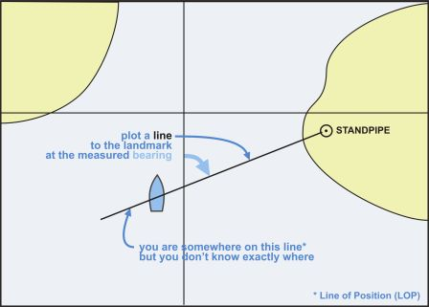
Bearings as LOPs
Fig 5-21B
1035
085 M

Slide 22
LOPs & Fix
At 2 pm (1400) a M bearing is taken on the tank
1400 FIX
1400
260 M
1400
250 M
Tank
1400
200 M
Then a M bearing is taken on the tower
Tower
Where the two LOPs cross is a FIX
Notes:
A class exercise for plotting a fix is presented in the “Additional Slides” after the end of the Session 2 presentation.
Plotting a fix using TVMDC+W will be presented in Session 3.

Slide 23
The Weekend Navigator
Planning with GPS

Slide 24
What is a Marine GPS?
Device to assist in planning, execution, and monitoring a marine voyage
Gets current position and time from satellites
Gets chart information from:
  Key stroked manually
  Navigation chart files
  Downloads
Calculates distance, lapsed time, speed, heading

Slide 25
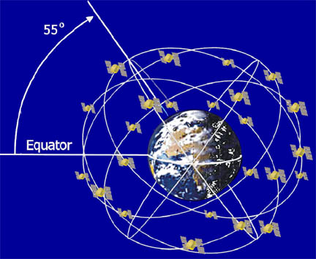
Satellite-Based System
Notes:
GPS is a satellite-based system.
A constellation of 30 satellites orbit the Earth, and 24 are activated at one time. They view virtually every place on Earth.
In order to provide a position solution on the ground, at least three satellites must be in view at the same time. A forth satellite is required to determine elevation.
They orbit at about 12,000 miles

Slide 26
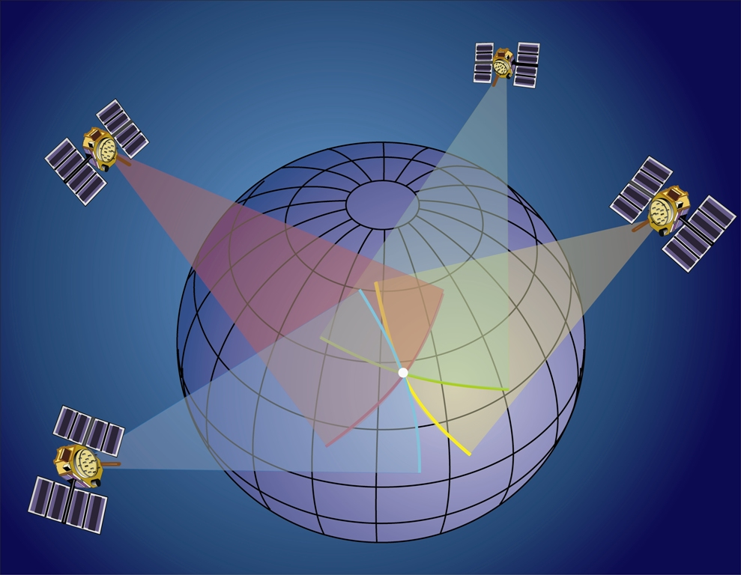
3-D Fix with 4 Satellites
NOTE Replace with Fig 4-31 b
Fig 4-31
Notes:
The entire mission of the satellites is to provide you with a position.
The satellite sends out a signal that includes its location along with the time the signal is sent.
The receiver has a clock that compares the time sent with the time received.
The receiver can figure out its distance from the satellite using, essentially, 60D Street!
Since the receiver was also given the satellites location, it can compute where the receiver is located in relation to the satellite.
This gives a circle on the earth where that same distance occurs; a circle of position.
Do this for more than two satellites and the receiver can give its owner a FIX.
There are two levels of fix that will provide you with a navigation solution, i.e., a position. A 2-D solution can be derived from at least three satellites. Three satellites provide three circles. Where all three coincide is the receiver's actual location on earth. The forth satellite provides verification that one of the other three are not in error. This assumes that you are located on the surface of the Earth.
The more accurate position is the 3-D navigation solution that requires at least four satellites in view and providing signals to your GPS receiver. The forth satellite provides the elevation . The 3-D fix is generally accurate to about 30 feet along the surface of the Earth.

Slide 27
GPS Accuracy
Basic GPS
  Typical accuracy: within 30 feet
GPS Augmentations
  Differential GPS (DGPS)
    Typical accuracy: within 15 feet
  Wide Area Augmentation System (WAAS)
    Typical accuracy: within 10 feet
Notes:
GPS is accurate to within 50 feet most of the time and about 30 feet is typical.
That accuracy increases using “augmentations.” There are two systems available in the U.S.
DGPS (Differential GPS) is operated by the U.S. Coast Guard. With DGPS typical accuracy is to within 15 feet.
WAAS (Wide Area Augmentation System) is a system operated by the FAA . This system was designed for airplanes, but works just fine for boating. With WAAS-enabled GPS, typical accuracy is to within 10 feet. WAAS- like systems have been replicated around the world

Slide 28
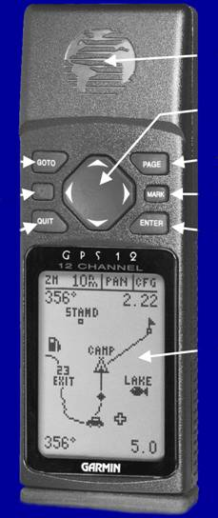
Typical GPS Buttons
ANTENNA
CURSOR
GOTO
PAGE
POWER (light)
MARK
ENTER
QUIT
SCREEN
Notes:
This is an older unit, but the information on newer units will be the same perhaps in color and accessed by touch screen

Slide 29
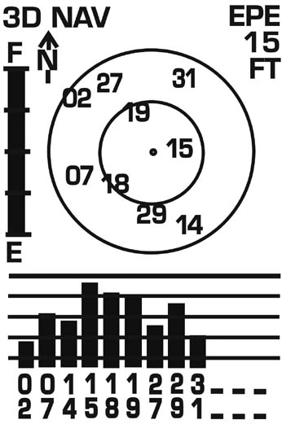
Satellite Screen
Status Field
Estimated Position Error
Battery Indicator
Skyview Display
Signal Strength Indicators
Notes:
All models offer a satellite screen. This screen is intended to provide you with information regarding the satellites that are being viewed and received. A skyview display shows the satellite numbers, and where they are located looking down on your present location. In this case, north is up. The bars represent the strength of the received signals from each satellite – the stronger the better. A solid bar (as shown) indicates that the satellite is being received and is providing navigation information. A hollow bar means that the satellite signal is being received but not useable.
Today, most GPS receivers can monitor up to 12 channels. This screen also tells you something about the quality of the fix. This model provides an indication of EPE (Estimated Position Error). This is a computed estimate of just how accurate your position will be based on the satellite geometry and signals. It is just an estimate, and is usually given in feet.
The status in this screen indicates “3D Nav” for 3-D navigation using four or more satellites. Other labels here include, “Acquiring Satellites” (no fix yet), “2D Nav” (only 3 satellites providing a fix), and others such as “Lost Signal”
The signal bars are meaningful in that they can be used to help you position the GPS. Locate the unit where the bars are as high as possible. If you block the antenna, you will find that some of the bars for that portion of the sky are very low or not indicating a signal.
When the GPS is turned-on and achieves an operational status, this screen typically shifts to a “Home” screen.

Slide 30
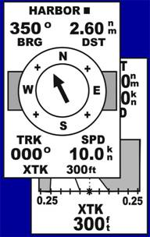
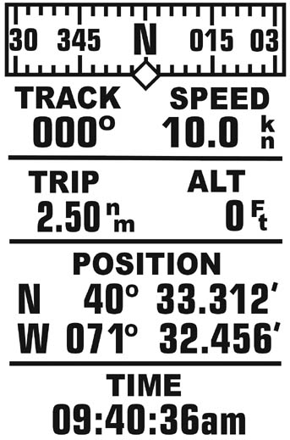
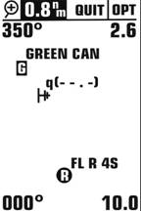
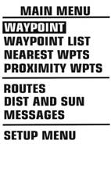
Typical GPS Screens
PAGE
QUIT
Pressing “Page” advances to next screen
Pressing “Quit” backs-up to previous screen
Notes:
This demonstrates an older model, but the concept of screens (called pages) progressing is universal.

Slide 31
GPS Setup
Newer GPSs have default settings
  Units of measure etc.
Settings can be changed
Settings found on main menu
Most functions locked until fully operational
Notes:
Settings sometimes called “Preferences”
Suggest explaining typical setting.
New users often confused by not knowing about the “Demonstration” setting.

Slide 32
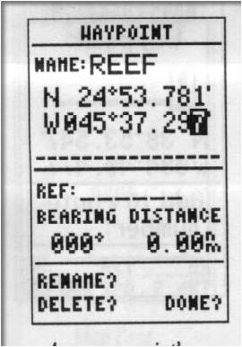
Waypoint Input
Older units — Manually inputted
GARMIN
Notes:
Waypoints must be manually entered.
These are typical basic GPS unit screens; i.e., Satellite, Position, Map and Highway screens
These Map screens demonstrated evolution of detail from older GPS receivers to the newer models. The newer units show an actual chart.

Slide 33
Waypoint Input- Newer Units
Waypoint can be extracted from map screen
  Point to desired place on map screen and “enter”
  Lat./Long. Automatically displays
  Enter new name
Notes:
All the places where it’s desired to go (Waypoints) are added here. Other screens or features are used to guide the boat from waypoint to waypoint to get to a desired destination.
Be Careful--Nearly 100% of waypoint entry errors are due to inattention and not re-checking. (Remember Korea Air Flight 007?)

Slide 34
Creating a Route
GPS can store routes
  Sequence of waypoints (WPT)
  Creates a sequence of “legs”
  Multiple Routes can be planned and recorded
Routes
  Can be activated – forward or reverse
  Can be edited
  Route page shows distance and bearing between waypoints
Notes:
The GPS can record a sequence of stored waypoints at a Route.
Routes have names, and can be activated in either direction.

Slide 35
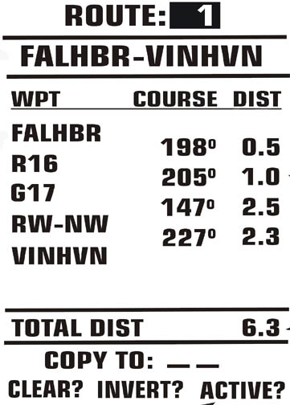
Route Definition Page
Route
Course of leg
Waypoint Name
Leg distance
Total distance
Notes:
The route is given a name to distinguish it from other routes.
The waypoints are entered in the desired sequence. All other data is entered automatically.
After it is saved it may be activated, which starts the process of giving steering course instructions.
The Go-To command is usually chosen to give steering instructions directly to a selected waypoint.

Slide 36
Marine GPS Models & Applications
Handheld
Fixed mount
Sending Unit
Navigation software/computer
Integrated in total system
Chartplotters
Notes:
Handheld- was used in this presentation
Fixed Mount- This model is usually bigger with a larger screen.
Sending Unit- contains all the functions of a GPS without any display or buttons. It is typically connected to a computer with Navigation S/W which converts the computer into an operational GPS.
Navigation S/W allows all the GPS planning to be executed on the computer.
Integrated Systems- connects the GPS to a Radar Unit, plus any other navigation devices. The Radar screen being the largest is typically chosen to display and control all the device, and view everything together under the command of the user.
Chartplotter- A GPS with accurate charts integrated into the system.

Slide 37
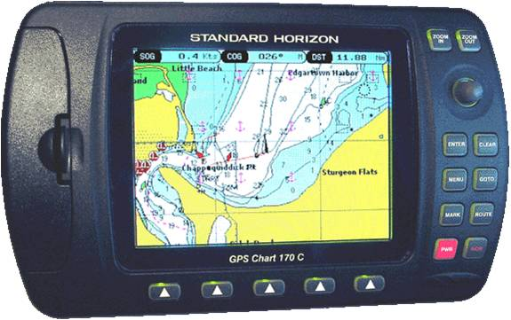
Chartplotter GPS
Integrates actual charts with GPS
User friendly to plan & execute trips
Chartplotter features vary w/ price
Notes:
While there is no standard, outside of the manufacturer’s marketing department , that provides the minimum requirements for a “Chartplotter,” it can be accepted as a generic term for almost any device larger than a handheld. Chartplotters span a huge variety of receiver capabilities and screen sizes, and in each family of devices, as the price increases, the number of “bells and whistles” increases, usually along with the screen size.

Slide 38
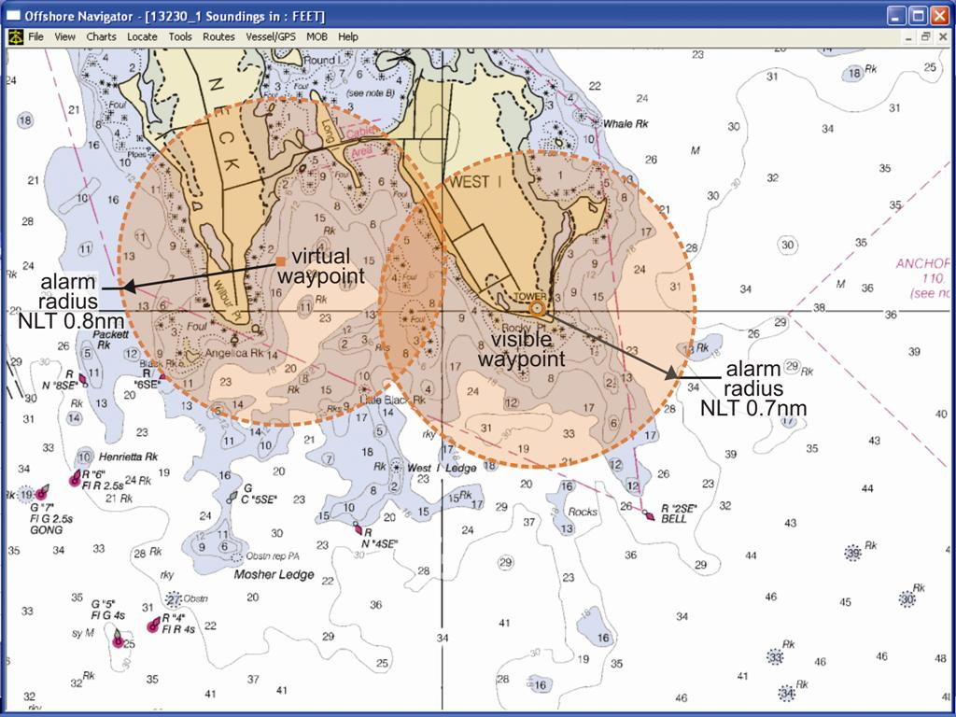
Chartplotter Features
Track/Trail
Split Charts
Display orientation
Zoom
Often integrates depth sounder info
Sophisticated alarms
Notes:
Track/Trails: Both terms used for the function that records and displays the course travelled by a boat
Split Chart: Allows a section of a chart to be zoomed and display both sections
Orientation: North-up or Course-up
Zoom: Zoom the chart currently displayed
Sophisticated alarms: Map screen shows danger areas and the waypoint with alarm set to isolate hazards.
AIS interface

Slide 39
Electronic Charts: Raster & Vector
Raster charts display the identical digital chart that’s used to create paper charts.
Vector charts display custom chart information created by a cartographer.
Notes:
Raster charts have the advantage of being error free by being an actual copy of s/w used to print that chart. Zooming in and out looks like using a magnifying glass.
Vector charts accurately extract the shore outline taken from the Raster file. However, the detail information is created by the cartographer which can be good or bad. When zooming in or out, the cartographer can add or alter beneficial detail information. Very expensive GPS units are always vector because a lot of resources are used to make the “friendly” custom charts

Slide 40
Caution
GPS can be too friendly
  Steering by viewing chartplotter map screen inhibits a “proper look-out”
  Piloting in close quarters using map screen is dangerous
  Steering using a navigation log/route plan is safer
  The chart is less accurate than the GPS position (e.g., within 80 meters at 1:80,000 scale)
Notes:
Steering with map screen is fine for marks that are miles apart. You can stare at the screen for 10-20 seconds with no risk.
Steering in a crowded channel surrounded with many marks close together requires concentration on the helm. A 10 second view of a screen in a crowded area is dangerous.
The chart on the GPS map screen is less accurate than the GPS position. This is taken from http://www.nauticalcharts.noaa.gov/nsd/DGPSchart.html
Chart Accuracy
For the chartmaker, the accuracy of the final product must take into account the limitations manifested by the chart user’s acuity of vision, lithographic processes and plotting techniques, and the symbolization of features (e.g., line widths).
The accuracy of a nautical chart is also dependent upon the accuracy with which its underlying data was collected and plotted on the final drawings and manuscripts used to print the finished chart. NOAA has specified accuracy standards at each step in the data collection and chart production process.
Specified Chart Accuracy
NOAA has specified the accuracy for its nautical charts in terms of the accuracy with which features are plotted on the chart from their original surveyed position. The plotting positional accuracy of most features is approximately 1mm at chart scale. To put this into perspective, at 1:20,000 scale 1mm is 20 meters and at 1:80,000 scale 1mm is 80 meters.

Slide 41
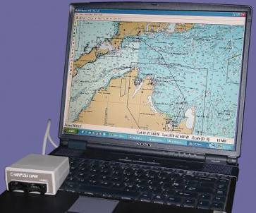
The Weekend Navigator
Planning with Charting Programs

Slide 42
Typical Software Features
Provides many charts and can import from NOAA website
Creates Waypoints on a chart
Connects waypoints making a Route Plan
Computes distance, bearing and time
Compiles all statistics on the route
Data can be uploaded to a GPS
Can be used directly with a GPS
Notes:
FREE navigation software can be obtained from these sites (use hyperlinks provided at http://www.nauticalcharts.noaa.gov/mcd/Raster/#software)
• Rose Point
• Global Navigation Software Co
• Maptech Raster Chart Software
• The CAPN Raster Chart Software
• GPSNavX
• Fugawi Marine ENC Software
• Caris Easy ENC
• SeaClear
• PolarView
• Memory Map
• Bluewater Racing

Slide 43
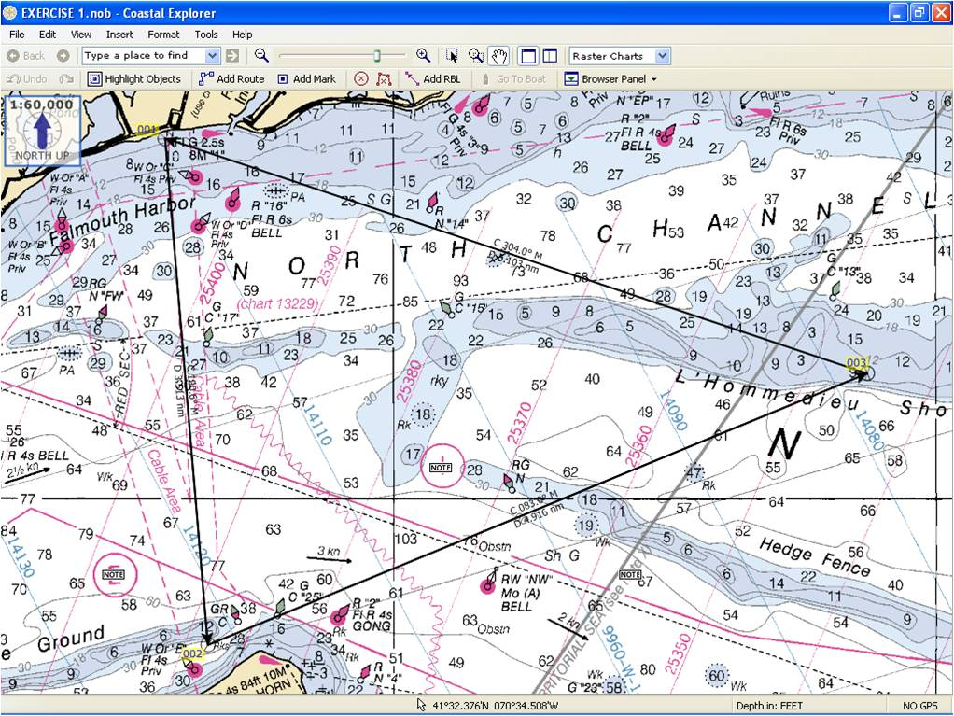
Notes:
Screen shot of Coastal Explorer demo program used for the Cruise Exercise.
FREE, limited capability programs for raster charts are available from http://www.nauticalcharts.noaa.gov/mcd/Raster/#software.
NOAA charts can be imported to Coastal Explorer.
All charting programs operate differently
Chartplotter GPS partially emulates functions in charting s/w

Slide 44
Route Plan
Copy function in the navigation program
Paste into a document and modify as desired for use
Name Bearing (Mag) Distance Total Distance Planned Speed Time Turn Latitude Longitude
Home to
"002" 190.618655 3.505022 8.604685 15.000000 20 min 113 Port 41.483359 -70.611749
"003" 82.958420 4.916333 13.521018 15.000000 14 min 107 Port 41.514650 -70.510638
"001" 303.997447 5.099663 5.099663 15.000000 20 min -ARRIVE 41.541568 -70.618327
Notes:
This is an example of a Navigation Log, called a Route Plan in the text, that is generated by the charting software.
Latitude and longitude expressions:
W longitude and S latitude are negative values.
E Longitude and N latitude are positive values.
Both are shown as whole number degrees and decimal minutes.

Slide 45
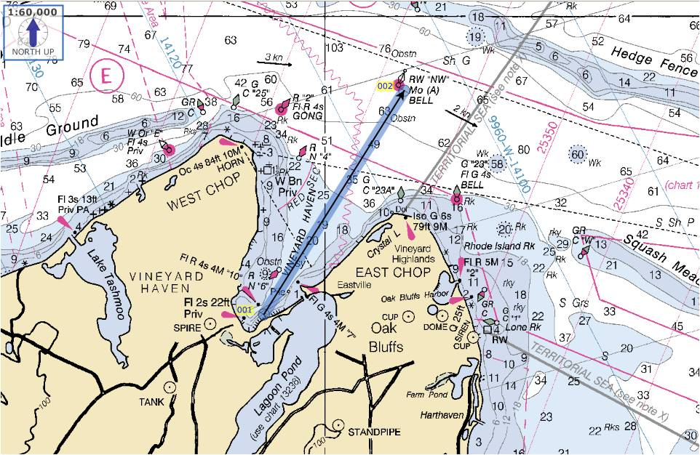
Create a Route
Notes:
Best technique for Creating a long complicated Route
Click on Route option
Click on starting waypoint
Click on destination waypoint

Slide 46
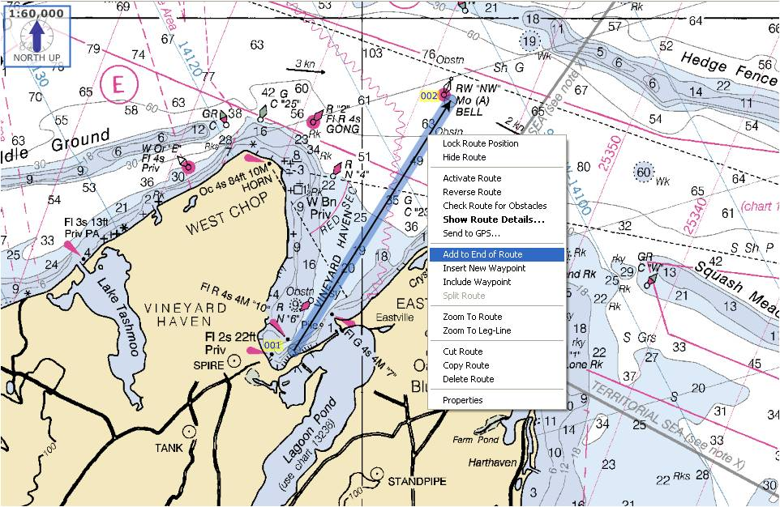
Add a Leg
Notes:
Typically, using a live demo. of a charting program is too time consuming. Also, they are all diferent in operation. Suggest using the following screens to step through the process.
Cursor to the start point and click.
Cursor to the first intermediate waypoint and click.
Cursor to destination waypoint and click

Slide 47
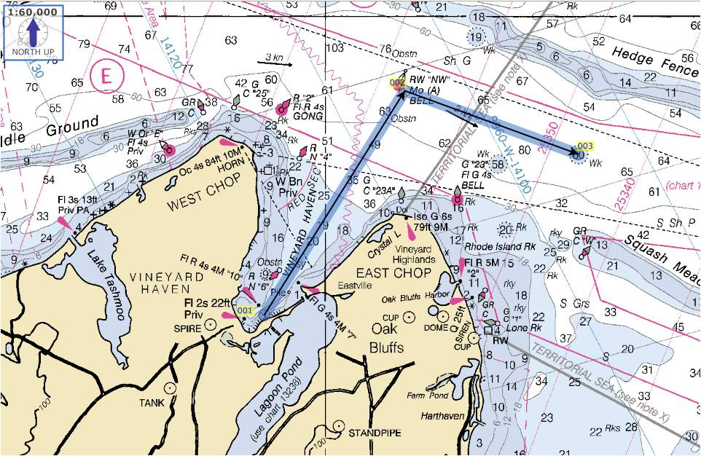
Add a Leg
Notes:
YOU HAVE COMPLETED A TWO LEG ROUTE--- It’s the same process to create a 20 leg route

Slide 48
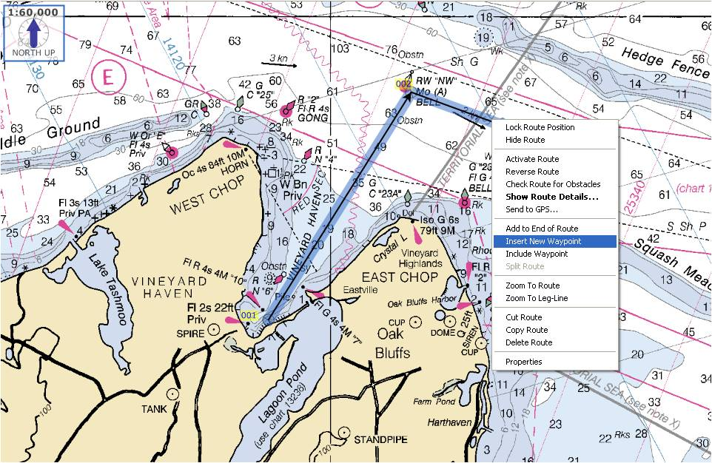
Change Route
Notes:
Click on option to add a “waypoint within a leg.”
The waypoint is added to the middle of the leg and moved to the desired location.

Slide 49
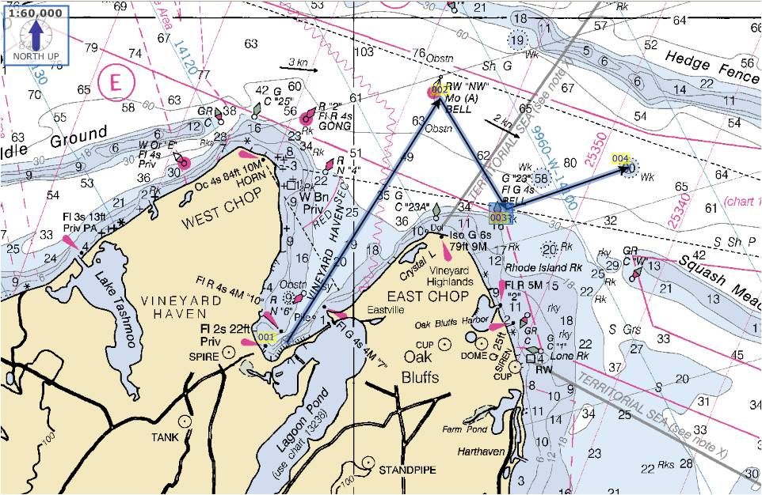
Change Route

Slide 50
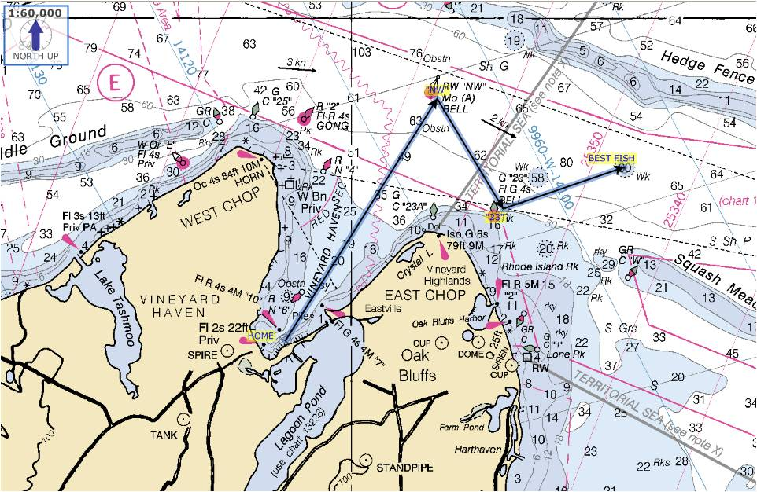
Naming Waypoints
Notes:
Choose the naming waypoint feature and name the destination of this route.
The chartplotter GPS will offer a similar feature to create a route

Slide 51
Recommendations
Offset waypoints from ATONs
Give waypoints unique names
Break routes into segments with unique names
Notes:
Offset: In restricted visibility this reduces the chance of a collision.
Break routes: Having several shorter routes provides ability to link various routes sequentially to increase flexibility.

Slide 52
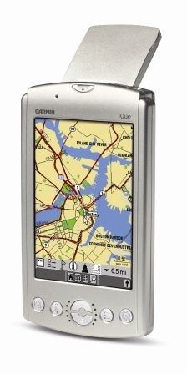
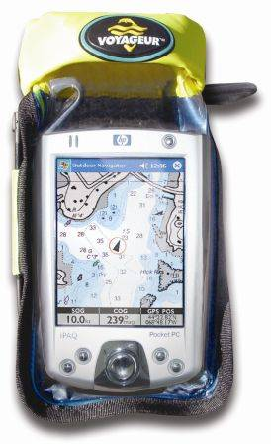
Other Tools – Tablet & Smartphone
Uses true GPS or cellphone GPS-like system
Capable of interfacing with GPS
Pros and Cons
Notes:
Advantages of using PDA
Rather inexpensive and quite common
Portable and handheld
Recent models are waterproof
May be able to access internet
General purpose and flexible
Disadvantages
Small size
Lack of marinization for the environment
Subject to power loss

Slide 53
The Weekend Navigator
Session 2 homework
Cruise Exercise #2
Chapters 6-9, 11-13
Notes:
Discuss homework and expectations for next session. If time remains, may start the Cruise Exercise in class.

Slide 54
The Weekend Navigator
Additional Slides

Slide 55
Class Exercise-Bearings
Use Chart 2 for this exercise
At 1622, a vessel observes the SPIRE at Vineyard Haven bearing 240° M. Where is the vessel?
From WPT 2 at L’Hommeaieu Shoal:
  What is the M bearing to the CUP at Oak Bluffs?
  232°
  What is the M bearing to the Falmouth Heights RADIO TOWER?
  326°
  The intersection of these two bearings is a _____.
Somewhere on the LOP 1622___
240 M
Fix

Slide 56
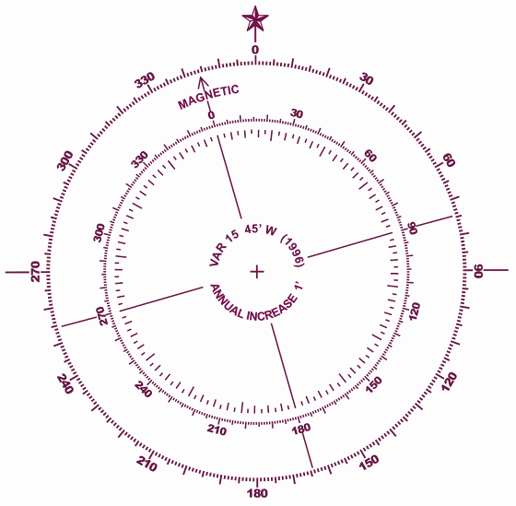
What are the M bearings? MH + RB = MB
045° R
045° M
310° R
310° M
000° M
090° R
090° M
Vessel
Heading
257° R
257° M
155° R
155° M
Notes:
The “X” are the targets given in slide 17.
Vessel’s M heading is shown in red off the bow. All illustrations start with 045° R.

Slide 57
What are the M bearings? MH + RB = MB
045° R
045° M
310° R
310° M
000° M
090° R
090° M
Vessel
Heading
257° R
257° M
155° R
155° M
Notes:
The “X” are the targets given in slide 17.
Vessel’s M heading is shown in red off the bow. All illustrations start with 045° R.

Slide 58
What are the M bearings?
045° R
310° R
340° M
030° M
075° M
257° R
287° M
Vessel
Heading
090° R
120° M
155° R
185° M

Slide 59
What are the M bearings?
257° R
030° M
045° R
155° R
290° M
310° R
085° M
Vessel
Heading
135° M
090° R
225° M
180° M

Slide 60
What are the M bearings?
155° R
090° R
023° M
318° M
045° R
273° M
228° M
Vessel
Heading
257° R
125° M
310° R
178° M

Slide 61
The Weekend Navigator
End Additional Slides

